Slide 1

RIVER DELTA
GLOBAL FRONTIER FUND
The Leading Asia-Based Global Allocation Fund of Hedge Funds
Cayman Exempted Company | Hong Kong SFC Licensed
[Input Month] 2025

Slide 2



Key Investment Highlights
River Delta Global Frontier Fund
All-Weather & Long Time Horizon
Consistent profitability across all market environments through different cycles. Track record with no down year since inception in 2017.
Low Correlation & Absolute Return
Portfolio construction focused on absolute returns regardless of market direction. Performance curve with near zero correlation to major indices.
Institutional Setup & Access
Institutional architecture providing unique access to exclusive investment opportunities across major global markets.
Global Allocation & Asian Expertise
Pioneer in Asian global hedge fund investment, offering balanced allocation leveraging unparalleled regional insights.
50%
Asia
50% US/EU
[Input]%
Annualized Return
[Input]
Sharpe Ratio
[Input]
Sortino Ratio
[Input]%
Total Return
Performance data since inception of January 2017 through [Input Month] 2025

Slide 3
Table of Contents
River Delta Global Frontier Fund
Fund Overview
Philosophy in Action: Investment Process Overview
RDGFF Investment Team
9
17
Cover Page
1
Key Investment Highlights
2
Evolution of Our Portfolio
10
Fund Terms
18
Table of Contents
3
Portfolio Construction Methodology
11
Regulatory Compliance & Fund Structure
Executive Summary
4
21
Manager Sourcing & Due Diligence Framework
12
Contact & Next Steps
Investment Approach
22
Risk Management Framework
13
Investment Philosophy Core Principle
Performance & Team
Appendix
5
Asset Allocation Methodology & Philosophy
Track Record: Performance Highlights
14
Portfolio Track Record
23
6
Strategic Portfolio Construction
Full Track Record & Risk Metrics
River Delta Wealth Management Background
7
15
34
Portfolio Integration
8
Performance in Historical Downturns
Strategic Partnerships
16
38

Slide 4




Executive Summary
River Delta Global Frontier Fund
Investment Manger Background & Strategy
Unique Value Proposition
2016
Single Family Office
2022
Multi-Family Office
2023
Asset Management
Investment Strategy
Consistent risk-adjusted returns through balanced allocation: 50% Asia / 50% US-EU, leveraging Asian expertise with global diversification.
Idiosyncratic Alpha
Consistent returns regardless of market direction
One-Stop Solution Family office services and asset management
Asia Expertise Unparalleled access to Asian opportunities
50% Asia
50% US/EU
Core Differentiators
RDGFF provides access to a diversified hedge fund portfolio generating idiosyncratic alpha with low correlation to markets.
SFC Licensed: HKSFC Type 4 & 9 licensed Investment Manager
Elite Network: Successful fund managers as LPs
Target Investors
Asia Advantage: Deep expertise in Asian hedge funds
Ultra High Net Worth Individuals seeking portfolio diversification
All-Weather: Consistent returns across market cycles
Family Offices looking for institutional-quality alternatives
Institutional Investors seeking stable long-term performance

Slide 5



Investment Philosophy Core Principles
Robust, risk-adjusted returns by a globally diversified portfolio
Global, Strategic Perspective
Guides portfolio construction and every investment decision through a forward-looking, disciplined lens. Our approach leverages the structural differences across regions while maintaining strong diversification since inception.
Pure Alpha Oriented, Not Beta Bets
Our allocations are designed to deliver true, skill-based alpha and are not intended to chase market direction or common risk factors. We select each holding for skill-based performance and low correlation to indices or peers, ensuring idiosyncratic returns in all weather conditions.
Disciplined, Repeatable Process
Risk controls and deep manager due diligence are embedded throughout our operating model since inception. Multiple layers of oversight—at manager, strategy, and aggregate levels—ensure no single source of risk dominates outcomes.
Dual Sub-Portfolio Approach
Leveraging our team's experience in Asian hedge fund markets and pioneering in accessing opportunities in developed markets, we employ a strategic dual approach that harnesses differentiated sources of alpha from each region.
Asia Portfolio US/EU Portfolio
Core-Satellite Structure Multi-Dimensional Diversification

Slide 6


Asset Allocation Methodology & Philosophy
Diversified hedge fund portfolio generating idiosyncratic alpha
ASIA Portfolio (50%): Core-Satellite Approach
US/EU Portfolio (50%): Multi-Dimensional Approach
Core Holdings ~35%
Satellite Positions ~15%
Diversified Strategies each ~2.5%
Asia Portfolio 50%
US/EU Portfolio 50%
Core-Satellite Structure
Multi-Dimensional Diversification
Harnessing our deep local knowledge, buy-side relationships, and proprietary research
Across managers, strategies, and styles, reflecting market maturity and breadth
Core Holdings (~35%): Sizable allocations to high-conviction managers and strategies
Satellite Positions (~15%): Smaller exposures to emerging or specialist managers
Broad Universe: Access to many distinct, even niche strategies Alpha Diversity: Multiple uncorrelated sources of alpha
(each~2.5%)
High Conviction Local Edge
Strategy Diversity Measured Sizing
Core-Satellite Strategy
Higher concentration in core positions Local information advantage
Early access to emerging managers
Multi-Dimensional Strategy
Broader diversification across strategies Institutional-grade risk management More even position sizing approach

Slide 7






Strategic Portfolio Construction
Strategic Construction Framework
Efficient Frontier Focus
Optimal risk-adjusted returns across asset classes and strategies, pursuing modern portfolio theory's efficient frontier
Multi-Dimensional Diversification Strategic allocations across asset classes, investment styles, and geographic regions
Dynamic Capital Deployment Tactical adjustments within strategic allocations responding to evolving market conditions
Our Investment Thesis
"We are dedicated to delivering robust, risk-adjusted returns by building a globally diversified portfolio focused on capturing idiosyncratic return across all market environments, with disciplined volatility and liquidity management embedded throughout the process."
Strategic Allocation
Strategic
Allocation
Strategic Portfolio Management
Manager Selection
Performance Review
Risk Management
Progressive Portfolio Evolution
Portfolio development since 2016 through expanding global market penetration.
Integrated Risk Controls
Multiple layers of risk assessment from manager to portfolio level.

Slide 8
Portfolio Integration
Strategic Integration Methodology & Global Summary
Strategic Integration Framework
Strategic Asset Allocation
Strategic Asset Allocation sets the long-term target, with periodic tactical tilts informed by our macro views—always within a disciplined framework respecting liquidity and implementation risk.
Risk
Portfolio
Tactical
Tactical Adjustments include regional allocation sizing, thematic overlays, and style/strategy mix calibration while maintaining strategic balance.
Management
Integration
Adjustments
Cycle
Cross-portfolio correlation and risk exposures are actively monitored to achieve resilience across market cycles, ensuring consistent performance.
Performance Monitoring
Dynamic Rebalancing maintains optimal positioning, preserving balance between alpha generation and risk management across sub-portfolios.
In Summary
Our fund of hedge funds is the product of deep regional expertise and disciplined global diversification. We construct a forward-looking portfolio that dynamically balances conviction in core holdings with broad-based, low-correlated alpha sources—from both Asia and the developed West. This delivers a resilient, steadily compounding return profile that stands apart from market cycles and peer benchmarks.

Slide 9



Philosophy in Action: Investment Process Overview
Systematic approach to generating alpha through manager selection and global allocation
Global Sourcing
Strategic Allocation
Alpha Selection
Due Diligence
Monitoring
Strategic Manager Selection
Portfolio Construction
Global Sourcing with Asian Focus
Leverage deep Asia connections and global network & database to identify managers with idiosyncratic alpha potential
Strategic Allocation
Balanced regional exposure with 50% Asia / 50% US-EU framework
1
4
Enhanced Due Diligence
Rigorous analysis focused on uncorrelated return drivers and all- weather performance
50 % Asia
Continuous Monitoring
50 % US/EU
2
5
Ongoing evaluation focused on maintaining low correlation to each other & major indices through all cycles
Alpha Selection
Systematic evaluation of strategy uniqueness and low market correlation characteristics
3
River Delta's Edge in Manager Selection
Unparalleled access to elite Asian hedge fund managers Proprietary methodology for identifying all-weather alpha

Slide 10
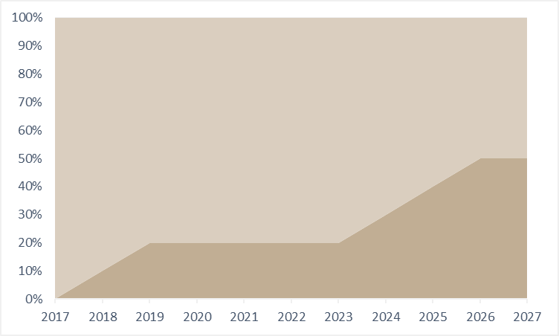
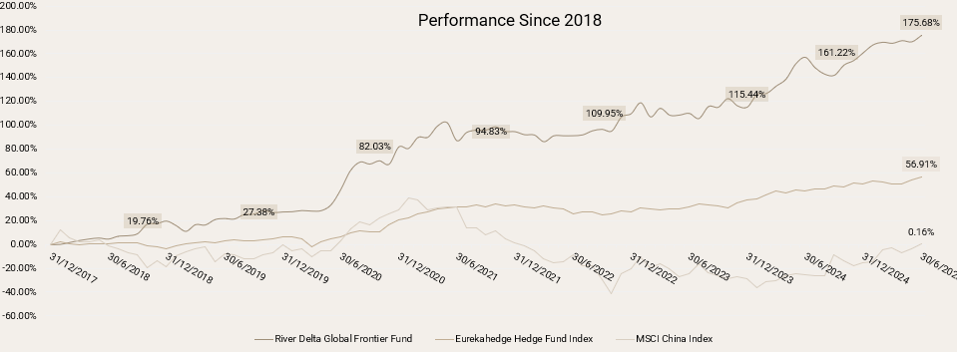
Evolution of Our Portfolio
From Single Family Office to Global Asset Management Platform
Institutional Evolution Timeline
2016
Founded as a Single Family Office in Hong Kong
2017-2018
Expanded from Asian-focused portfolio to global allocation
2022
Expanded into Multi-Family Office, maintained all weather, long horizon approach
2022-2023
Asset Management Platform, SFC Type 4 & 9 licenses
2024-Present
Launched RDGFF with balanced regional exposure
Geographic Allocation Evolution
[INPUT UPDATED GRAPH]
Asia US/EU
Current Geographic Allocation
Performance remained strong during the portfolio reallocation period
Core Principles
Institutional Evolution Family office heritage understanding
SFC licensed asset manager
Balanced geographic expertise
Family capital to institutional asset management
Focus on idiosyncratic alpha across cycles
Asia expertise balanced with US/EU allocations
[INPUT UPDATED GRAPH]

Slide 11




Portfolio Construction Methodology
Building Resilient, Alpha-Driven Portfolios
Our Portfolio Construction Philosophy
We construct a forward-looking portfolio that balances conviction in core holdings with broad-based, low-correlated alpha sources—from both Asia and the developed West—delivering a resilient return profile that stands apart from market cycles.
Efficient Frontier Focus
Optimizing portfolio along the efficient frontier for maximum risk-adjusted returns
Multi-Layered Diversification
Strategic diversification across geography, strategy, style and manager
Manager Selection
Evaluating skill, repeatability and transparency with superior networks
Dynamic Risk Controls
Integrated risk management with scenario testing and liquidity monitoring
Continuous Evolution
Portfolio adaptation to market developments and superior strategies
Implementation Process
Our disciplined process follows a systematic cycle: Strategic allocation → Manager selection → Portfolio integration → Risk management →
Continuous evolution, adapting to changing market conditions.

Slide 12

Manager sourcing & due diligence framework Institutional-Level Evaluation Our Approach Multi-Factor Due Diligence Protocol
Implementation of institutional-caliber sourcing and due diligence methodologies commensurate with established university endowments, sovereign wealth funds, and pension funds
Strategic Manager Identification - Leveraging institutional networks and proprietary sourcing channels
1
Quantitative Factor Analysis - Multi-dimensional performance attribution focused on alpha persistence
Manager Sourcing Infrastructure
2
Qualitative Investment Assessment - Comprehensive evaluation of investment process and decision frameworks
₂₀₀₀₊ Hedge funds systematically evaluated across global markets since inception
3
Operational Due Diligence - Rigorous verification of infrastructure, controls and compliance protocols
4
₂₀₀₊ Hedge funds subjected to comprehensive operational and investment due diligence
Systematic Monitoring Protocol - Continuous risk-adjusted performance evaluation across market regimes
5
₁₀₊ Global hedge fund conferences attended annually, providing access to institutional-grade managers
Analytical Framework Components
Quantitative factor decomposition - Proprietary performance attribution analysis identifying sustainable alpha generation and consistency metrics
₁₀₀ Hedge funds analyzed monthly through proprietary analytics platform
Counterparty intelligence network - Extensive verification through prime brokerage relationships and institutional limited partner connections
20
Hedge funds maintained under active due diligence across diversified strategy allocations
Operational infrastructure assessment - Institutional-grade operational due diligence questionnaire and independent third-party verification protocols
10
Hedge funds maintained in active pipeline for strategic portfolio allocations
Position-level risk analytics - Granular exposure monitoring and statistical risk decomposition at both position and portfolio aggregation levels
12
CONFIDENTIAL: For professional investors only

Slide 13


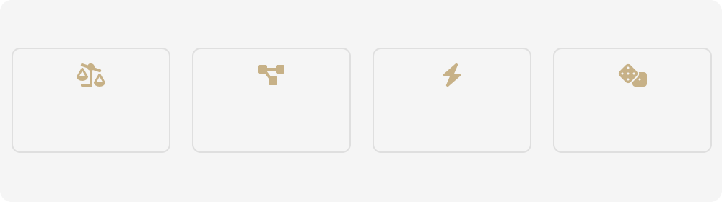


Risk Management Framework Institutional-Grade Risk Controls & Portfolio Protection
All-Weather Risk Management Philosophy
Our risk framework generates idiosyncratic alpha with low correlation to major markets through sophisticated identification, measurement, monitoring, and mitigation.
Liquidity Management
Superior Liquidity Terms: Minimum 90% of underlying hedge funds maintain liquidity terms superior to RDGFF investor terms
Opportunity Reserve: Strategic liquidity buffer with enhanced cash yield management tools
Cash Optimization: Reserved liquidity cash management tools for enhanced cash yields during low deployment periods
All-Weather Performance Principles
Balanced 50/50 geographic exposure, continuous correlation monitoring, and strategic diversification maintain performance regardless of market direction.
Investor-Aligned Fee Structure: Management fees applied exclusively to deployed capital, creating direct alignment with investor interests and optimizing investment economics
50% Asia 50% US/EU
Risk Mgt & Monitoring
Real-time Tracking: Intra-month weekly performance updates on core holdings through exclusive channels
Tactical Shift: Tolerance of up to 10% AUM for tactical allocations, semi-annual review with annual rebalancing
Low Correlation Strategy Controls
Cross-Region Diversification
Correlation Analysis
Alpha Stress Testing
Multi-Market Scenarios
Drawdown Response Protocols:
-2.5%: Triggers comprehensive portfolio review
-5.0%: Triggers corrective actions on portfolio imbalance
Idiosyncratic Alpha Focus: Continuous measurement of factor exposures
Multi-factor Risk Model: Incorporates Asian and Western dynamics Strategic Overlay: Tactical hedges for all-weather performance
13
CONFIDENTIAL: For professional investors only

Slide 14
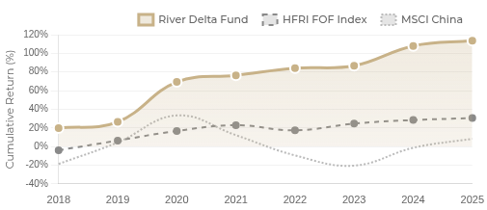

Track Record: Performance Highlights
Since 2017 till [INPUT MONTH] 2025
Idiosyncratic Alpha Performance Calendar Year Performance
Year | Fund | HFRI | S&P 500 | MSCI China
2018 | +19.8% | -4.0% | -4.4% | -18.7%
2019 | +6.4% | +10.4% | +31.5% | +23.1%
2020 | +42.9% | +10.3% | +18.4% | +29.0%
2021 | +7.0% | +6.2% | +28.7% | -21.2%
2022 | +7.8% | -5.6% | -18.1% | -21.7%
2023 | +2.6% | +7.3% | +24.2% | -11.0%
2024 | +21.3% | +3.8% | +18.6% | +19.1%
[INPUT UPDATED CUMULATIVE RETURN]
Key Metrics (Annualized)
2025
YTD
[INPUT UPDATED YTD]
NET RETURN
TOTAL RETURN
SHARPE RATIO
+5.5%
+2.1%
+6.3%
+9.7%
15%
Since inception
176%
Portfolio formation
1.4
Risk-adjusted
Avg Monthly Return
+2.54% (positive)
Downside Protection
-1.68% (negative)
[INPUT UPDATED FACTSHEET FIGURES]
SORTINO RATIO
MAX DRAWDOWN
VOLATILITY
[INPUT UPDATED FACTSHEET FIGURES]
3.0
Downside risk
-7.88%
Capital preservation
10.31%
Annual
MSCI China β
0.042 (near-zero)
MSCI Global β
-0.001 (uncorrelated)
14
CONFIDENTIAL: For professional investors only
All-Weather Performance: Our 50/50 Asia/US-EU allocation strategy has consistently delivered stable returns across market cycles with a Sortino Ratio of 3.0.

Slide 15
Full Track Record & Risk Metrics
Of Our Flagship Fund of Hedge Funds Portfolio since inception from 2018
Historical Performances
Key Metrics
[INPUT UPDATED FACTSHEET FIGURES]
Annualized Return | 15%
Annualized Volatility | 10.31%
Sharpe Ratio | 1.4
Sortino Ratio | 3.0
Maximum Drawdown | -7.88%
Percentage of Positive Return Months | 67.78%
Average Return in Positive Months | 2.54%
Average Return in Negative Months | -1.68%
Beta Relative to MSCI China | 0.042
Beta Relative to MSCI World | -0.001
[INPUT UPDATED FACTSHEET FIGURES]

Slide 16
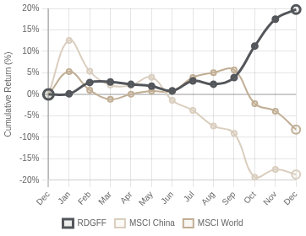
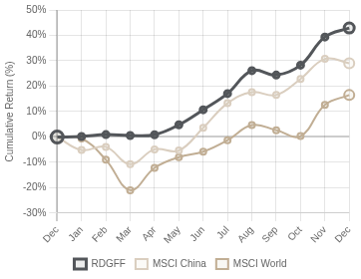
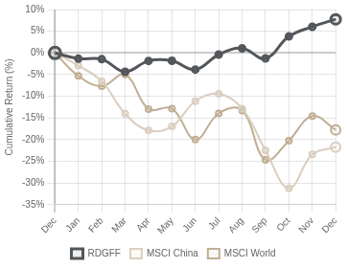


Performance in Historical Downturns
River Delta Global Frontier Fund in 2018, 2020 and 2022
2018 Market Correction
2020 Pandemic Shock
2022 Inflation Crisis
RDGFF: +19.76% MSCI World: -8.19% & MSCI China: -18.65%
RDGFF: +42.90% MSCI World: +16.52% & MSCI China: +29.01%
RDGFF: +7.76% MSCI World: -17.72% & MSCI China: -21.71%
Stability Amid Financial Crisis
In both 2018 and 2022, when global markets suffered severe drawdowns
(Global -8.19% / -17.72%, China -18.65% / -21.71%), RDGFF demonstrated strong downside resilience, finishing with positive returns of +19.76% in 2018 and +7.76% in 2022.
Resilience in Pandemic shock
During the 2020 pandemic crisis, RDGFF delivered exceptional performance with +42.90% returns, significantly outperforming both MSCI China (+29.01%) and MSCI All World (+16.52%).
This underscores RDGFF's ability to mitigate market stress—a defining characteristic of our idiosyncratic approach.
Diversification effect and absolute alpha strategy gives us excellent downside volatility management during pandemic shock.
+19.76%
2018 Return
+42.90%
2020 Return
+7.76%
2022 Return
3/3
Crisis Periods Outperformed

Slide 17

RDGFF Investment Team
Dedicated professionals responsible for RDGFF's portfolio management and investment decisions
Core Portfolio Management Team
Strategic Level
Research Team
Mid-Back Office
Jan Yang
Chief Investment Officer
Andy Lang
Kelly Wu
Lin Zi
Research Head
Chief Operating Officer
IR & BD
Eric Hon
Marshall Chang
Ephod Intelligence
Dennis Lyu
Samantha Lam
Global Macro Strategist
Fund Research Analyst
Quantitative Modelling
Risk & Operations Specialist
Administration Officer
RDGFF Team Advantage
The RDGFF investment team leverages complementary expertise to deliver consistent all-weather performance across multiple asset classes and market cycles. Their strength in identifying idiosyncratic alpha opportunities and implementing balanced 50/50 Asia-US/EU allocation ensures optimal diversification while capitalizing on unique regional insights.

Slide 18

Fund Terms
[UNLIKELY BUT VERIFY IF CHANGE]
River Delta Global Frontier Fund
Fee Structure
Service Providers
Investment Manager
River Delta Wealth Management
Management Fee
1%
Performance Fee
10%
Redemption Fee
2%
Administrator
Apex Fund Services Ltd.
Auditor
KPMG LLP
Class A, quarterly in arrear
Class A, annually
During 12-month soft lock-up
Legal Counsel
Ogier (Cayman) Jun He Law Offices (Hong Kong)
Custodian
DBS Bank (Hong Kong) Limited
Fund Structure: Cayman Islands
Fund Type: Open-ended Fund
Exempted Company
Operational Details
Regulation: Registered with CIMA
Minimum Investment: USD 10,000,000
High Water Mark
Yes
Liquidity Terms
Valuation
Monthly NAV
Subscriptions: Monthly
Redemptions: Quarterly
Lock-up: 12-month soft lock-up
Gate: 20% fund-level gate
Redemption Notice
60 days
Settlement
Normally within 60 days

Slide 19
Fund Terms
River Delta Global Frontier Fund
Fund Name | River Delta Global Frontier Fund
Structure | Cayman Islands exempted company incorporated with limited liability in the Cayman Islands under the Companies Act
Type of Fund | Open-ended Fund
Regulation | A 'regulated mutual fund' for the purposes of the Mutual Funds Act, registered with CIMA pursuant to section 4(3) of the Mutual Funds Act
Launch Date | 2 Sep 2024
Investment Objective | Invests in other hedge funds
Reference Currency | USD
Business Day | Hong Kong
Valuation Day | The last calendar day of each calendar month
Share Classes | Class A, Class E (Employee Class)
The above is a summary of the principal terms of the Fund. Please refer to the Fund's offering documents for complete information.
19
CONFIDENTIAL: For professional investors only

Slide 20
Fund Terms
River Delta Global Frontier Fund
Subscription | Monthly, first business day of each calendar month
Management Fee | 1% p.a., quarterly in arrear
Performance Fee | 10% p.a., annually
Redemption | Quarterly with 60 calendar days notice, Subject to 20% fund-level gate. The redemption request from one investor will be handled in a First-in-first-out method
Lock-up period | 12-month soft lock-up with redemption fee
Redemption Day | The first Business Day of March, June, September and December in each year
Min Subscription / Redemption for Class A | US$10 million / US$1 million
Redemption Fee | 2% during 12-month soft lock-up
Redemption Payment | Normally be made within 60 calendar days
Audit Holdback | 10% of the redemption proceeds
Accounting Standard | IFRS
Financial Year End | 31 Dec, first audit on FY 2025
The above is a summary of the principal terms of the Fund. Please refer to the Fund's offering documents for complete information.
20

Slide 21
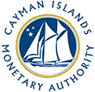
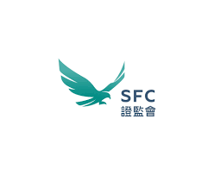
Regulatory Compliance & Fund Structure
Our commitment to transparency and industry best practices
Adherence to the highest Standards Fund Structure & Licensing
Performance calculations independently verified by
third-party accounting
Comprehensive track record since 2017
Cayman Islands Fund Structure
Structured as Cayman Islands exempted company, providing regulatory efficiency and tax neutrality
Company Background
Established 2016 in Hong Kong as a single family office
Hong Kong Licensed Manager
SFC licensed corporation holding Type 4 (Advising on Securities) and Type 9 (Asset Management) licenses
Evolved to multi-family office and asset management platform
Provider of one-stop family office services and asset management
Operational Excellence
Independent directors providing governance oversight
Annual financial statement audit by a Big Four accounting firm Independent fund administration with NAV calculation services

Slide 22
Contact & Next Steps
Begin Your Investment Journey with River Delta Global Frontier Fund
1 Initial Consultation
Understand your portfolio needs and diversification goals
2 Due Diligence
Two way due diligence process to ensure mutual fit
3 Investment
Complete subscription to our Cayman- based fund structure
Contact Us
Document Library
Investor Relations: ir@riverdeltawm.com
Fund Inquiries:
RDGFF@riverdeltawm.com
Private Placement Memorandum (PPM) - Detailed overview of River Delta Global Frontier Fund
Subscription Documents - Required paperwork for Cayman fund participation
Suite 1105, 11/F, ICBC Tower, 3 Garden Road Central, Hong Kong
Historical Performance Data - Our all-weather track record since 2017
22

Slide 23
Appendix Portfolio Case Study

Slide 24
Case one – Asian Core Holding
This Fund is a gradually built core holding since 2022, focused on Chinese equities across US, Hong Kong, and China markets. The fund employs an equity long/short strategy with a macro overlay, and consistently outperforms in market downturns due to the manager’s strong trading skill and ability to generate significant short-side alpha.
Key Metrics
[INPUT UPDATED HAO FACTSHEET FIGURES]
Annualized Return |  | Volatility | Sharpe Ratio | Sortino Ratio | Beta to MSCI China
34.80% |  | 26.52% | 1.31 | 2.89 | 0.13
Historical Performances
[INPUT UPDATED HAO FACTSHEET FIGURES]

Slide 25
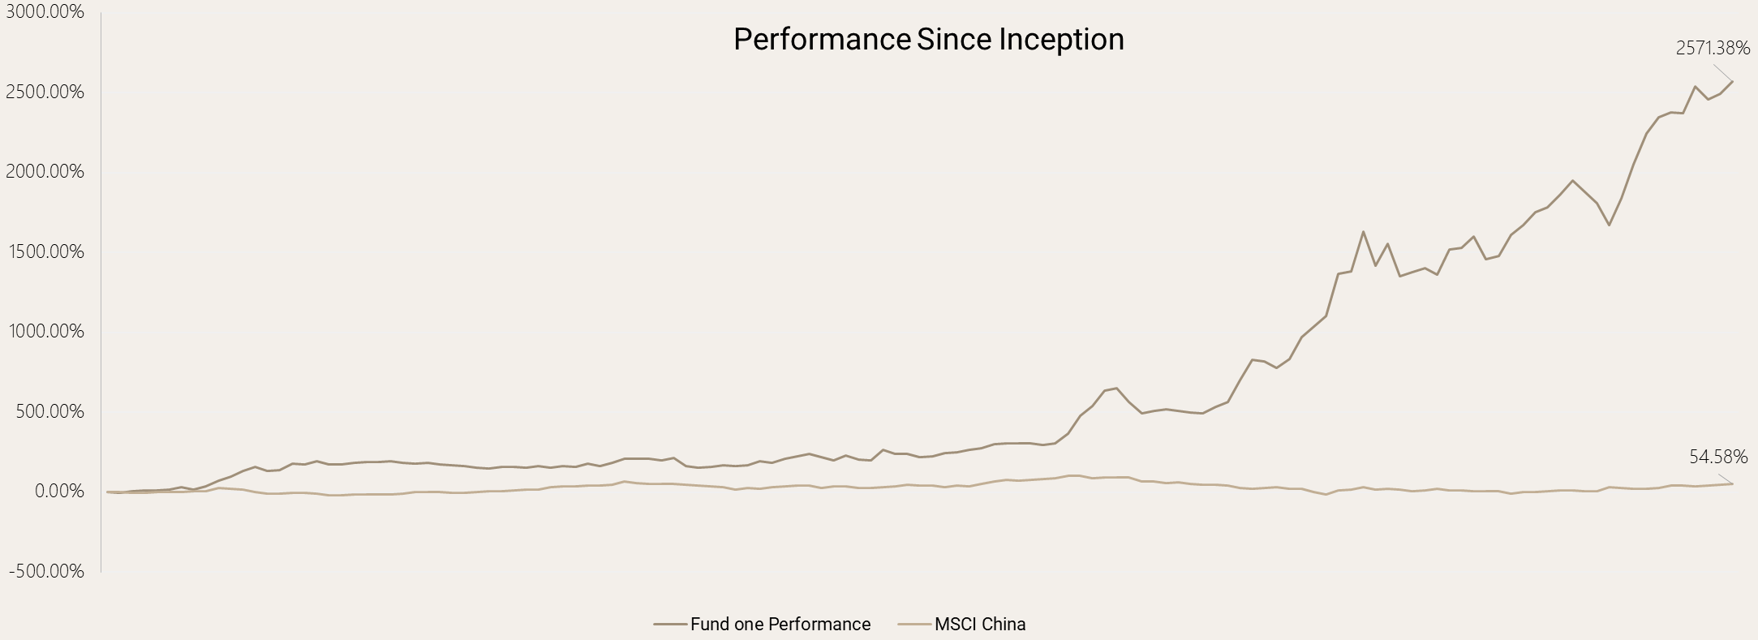
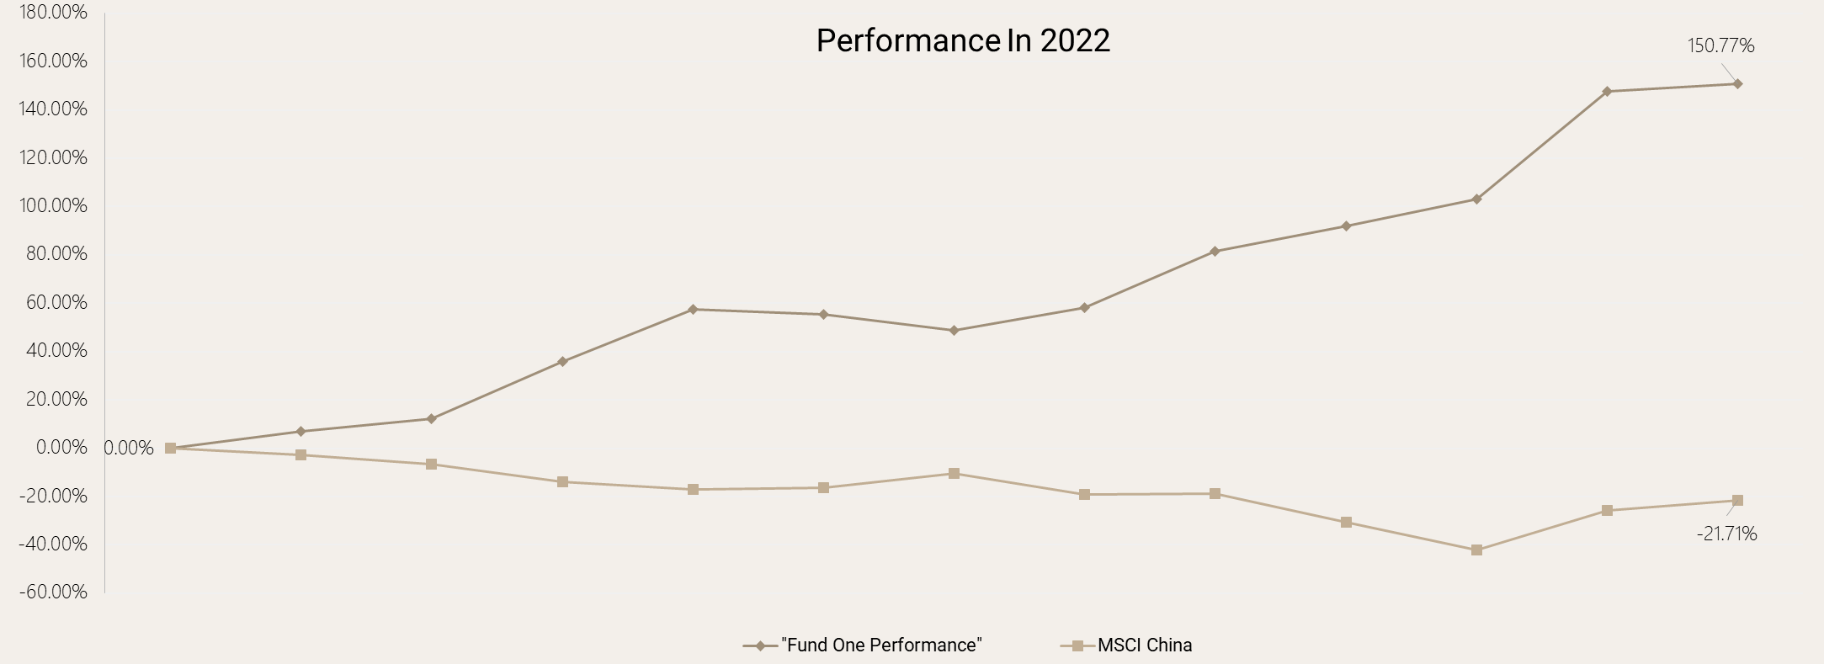
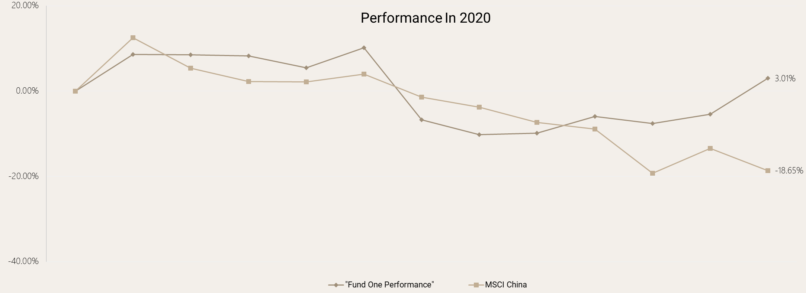
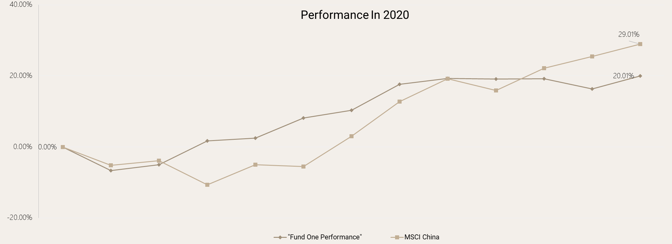
Past performances compared with benchmarks
[INPUT UPDATED HAO GRAPH]

Slide 26
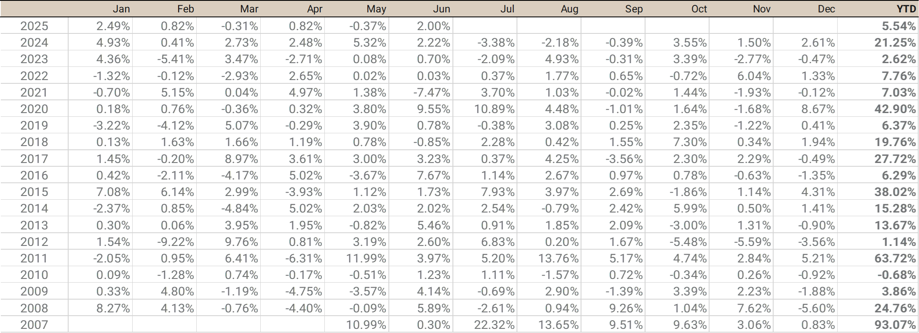
Case two – Core Holding Global Equity L/S
Core holding since inception, this fund pursues a global equity long/short strategy with low net exposure, targeting global opportunities through sophisticated hedging and trading skills. Managed by a legendary Asian hedge fund manager, it excels in capturing short alpha and performs strongly during market downturns. The fund has been hard closed and returning capital since 2020; our position is maintained due to an outstanding long-term relationship with the fund.
Key Metrics
[INPUT UPDATED TAIREN FACTSHEET FIGURES]
Annualized Return |  | Volatility | Sharpe Ratio | Sortino Ratio | Beta to MSCI China
21.02% |  | 17.51% | 1.09 | 2.13 | -0.13
Historical Performances
[INPUT UPDATED TAIREN FACTSHEET FIGURES]

Slide 27
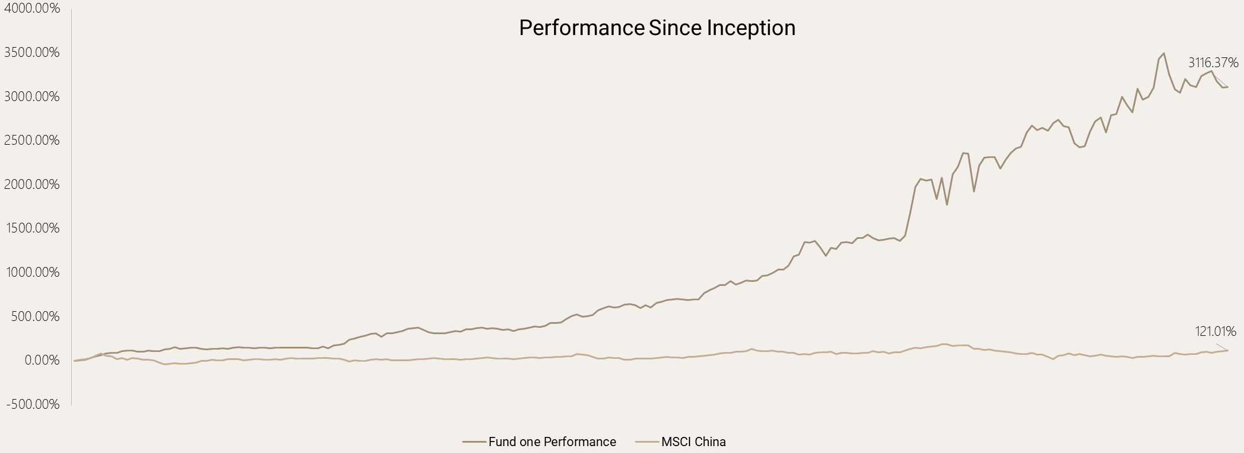
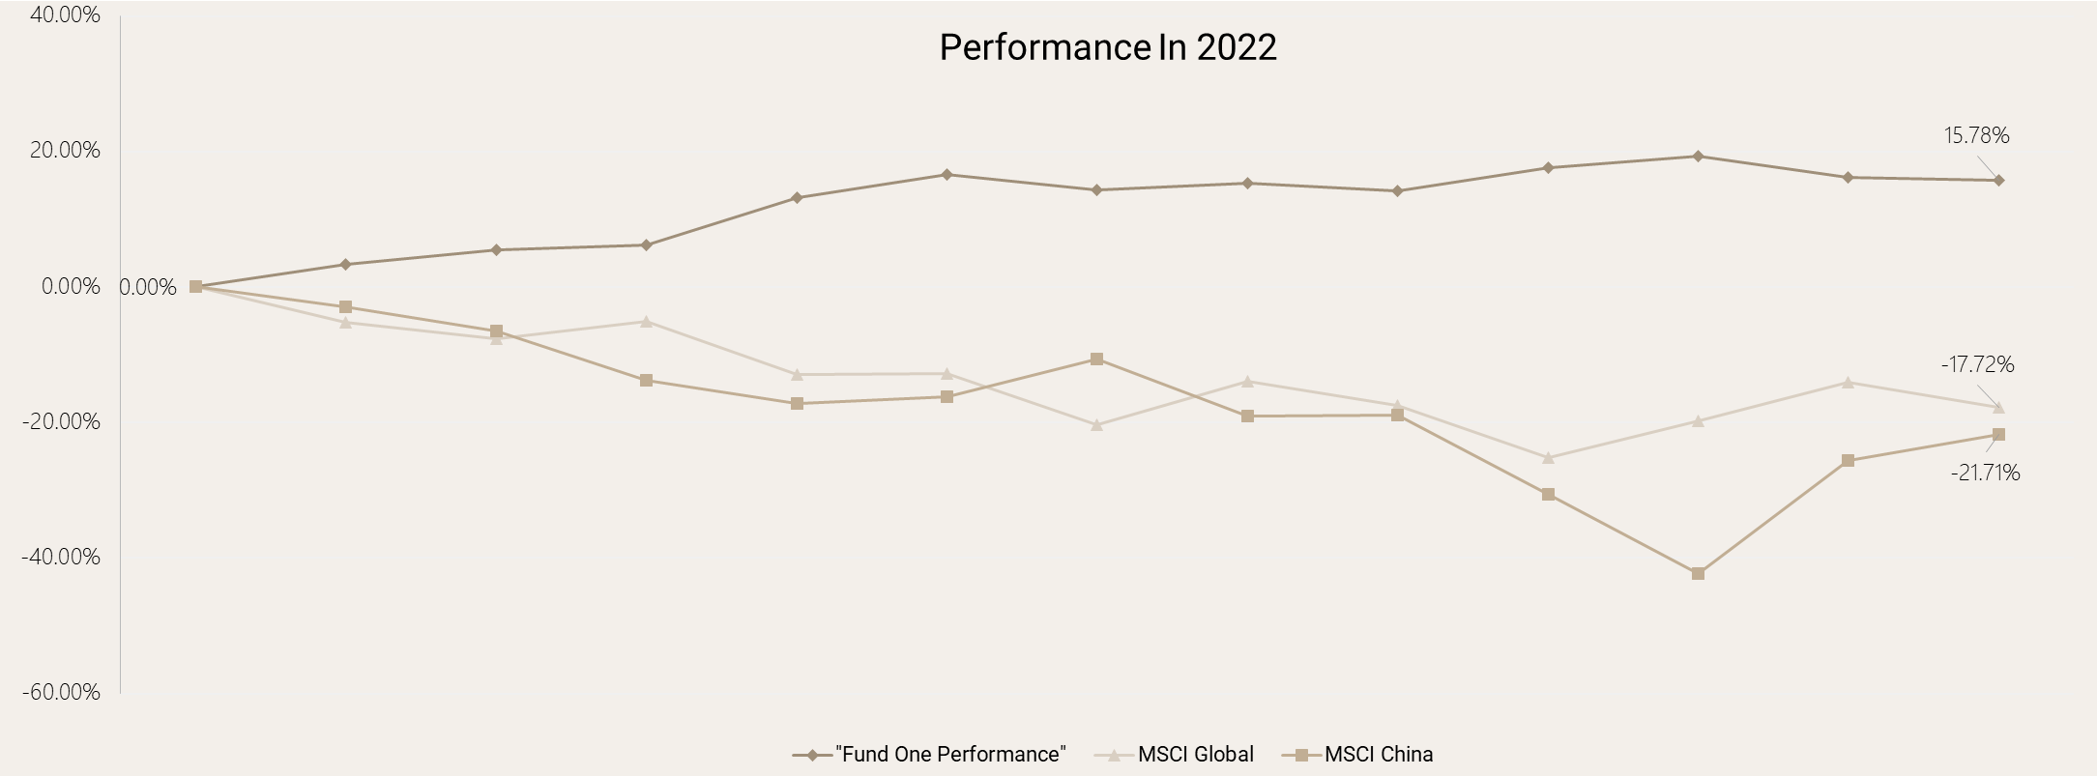
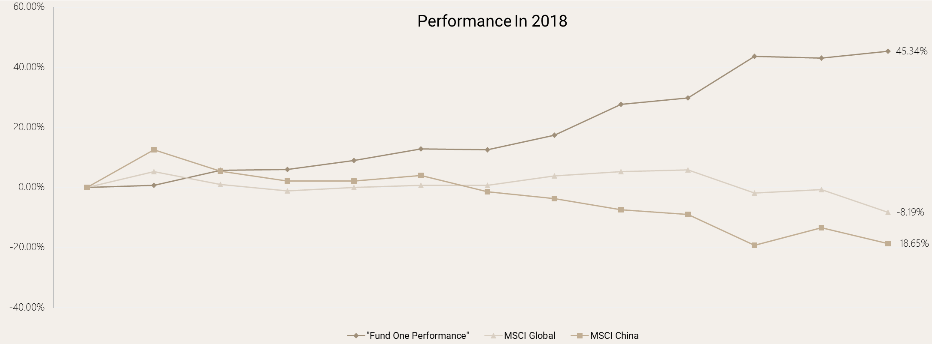
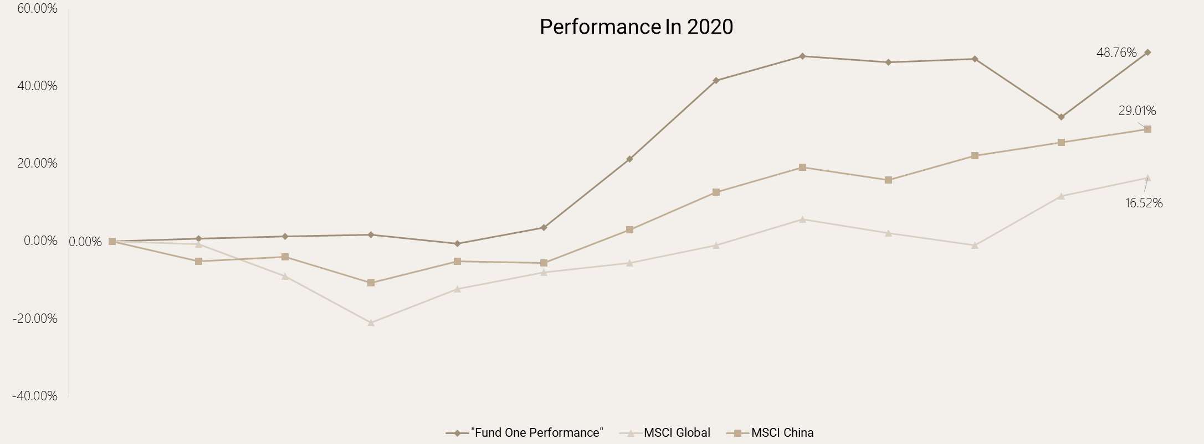
Past performances compared with benchmarks
[INPUT TAIREN UPDATED GRAPH]
Fund two
Fund two
Fund two
Fund two
Fund two

Slide 28
Case three – US Equity Low Net
This fund is part of our US/EU sub-portfolio and employs a US Equity Low Net strategy, blending technical analysis trading with fundamental stock picking. It captures both long and short alpha, demonstrating resilience during market downturns and delivering outperformance when markets trend upward. Run by an orthodox team in a US Jewish community, the fund remains relatively under the radar while targeting steady double-digit returns across all market environments.
Key Metrics
[INPUT UPDATED LEXINGTON FACTSHEET FIGURES]
Annualized Return |  | Volatility | Sharpe Ratio | Sortino Ratio | Beta to S&P 500
24.98% |  | 14.76 | 1.58 | 3.89 | 0.31
Historical Performances
[INPUT UPDATED LEXINGTON FACTSHEET FIGURES]

Slide 29
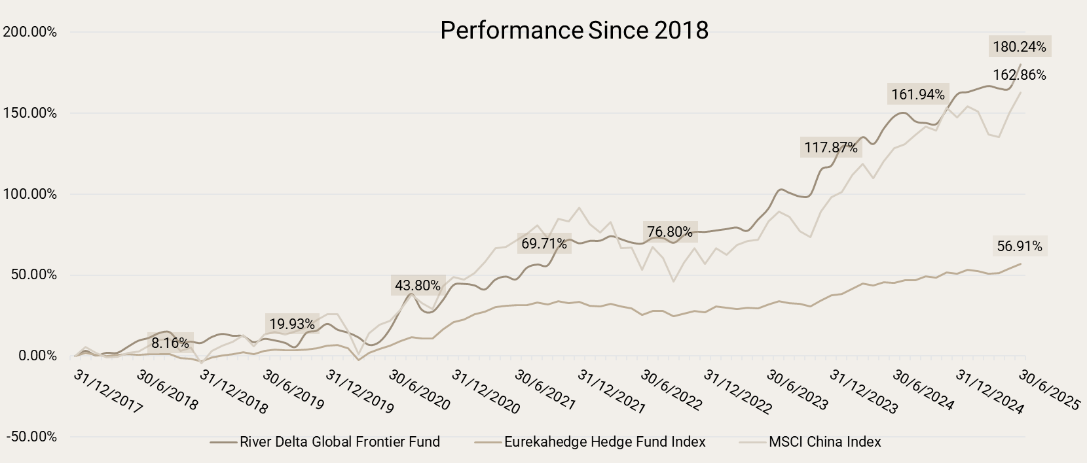
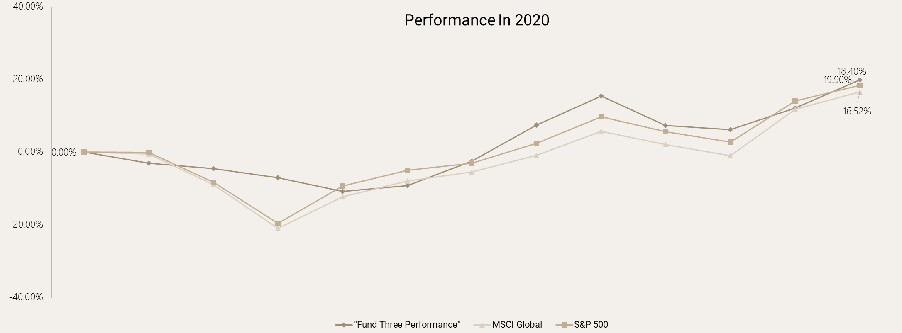
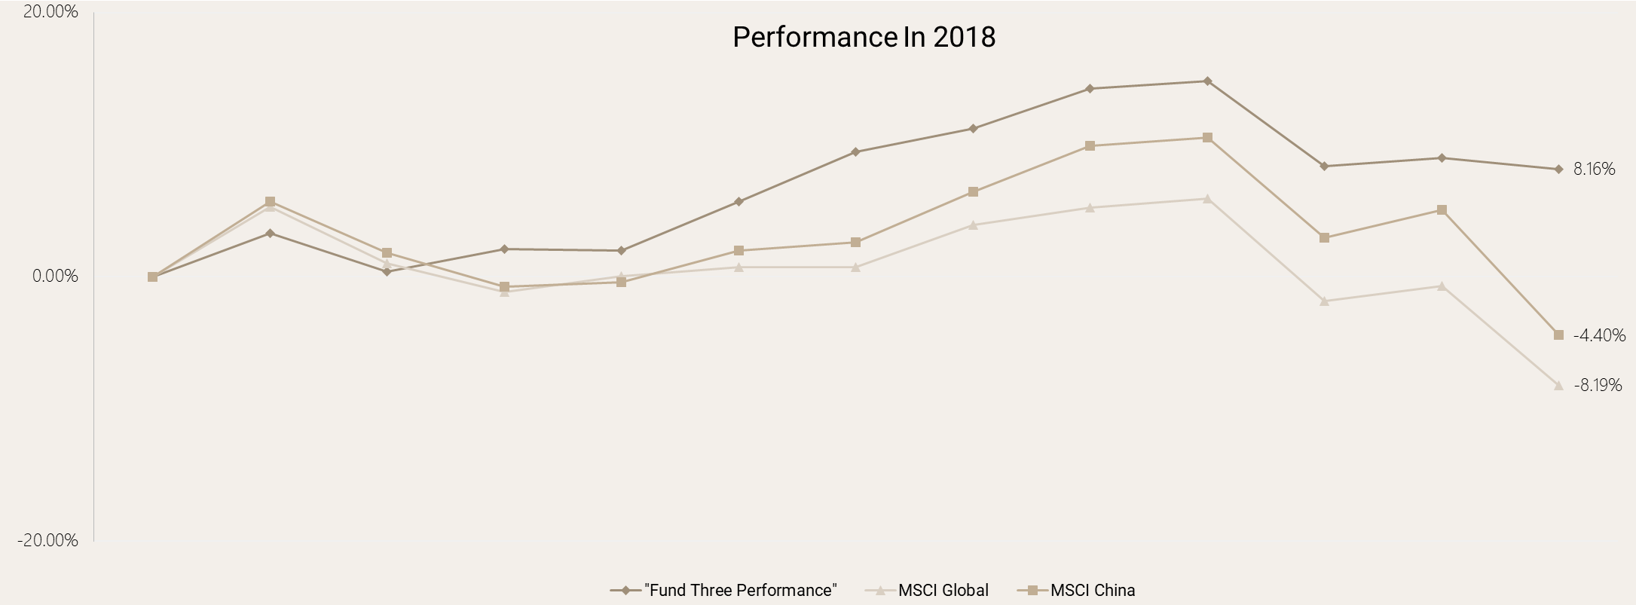
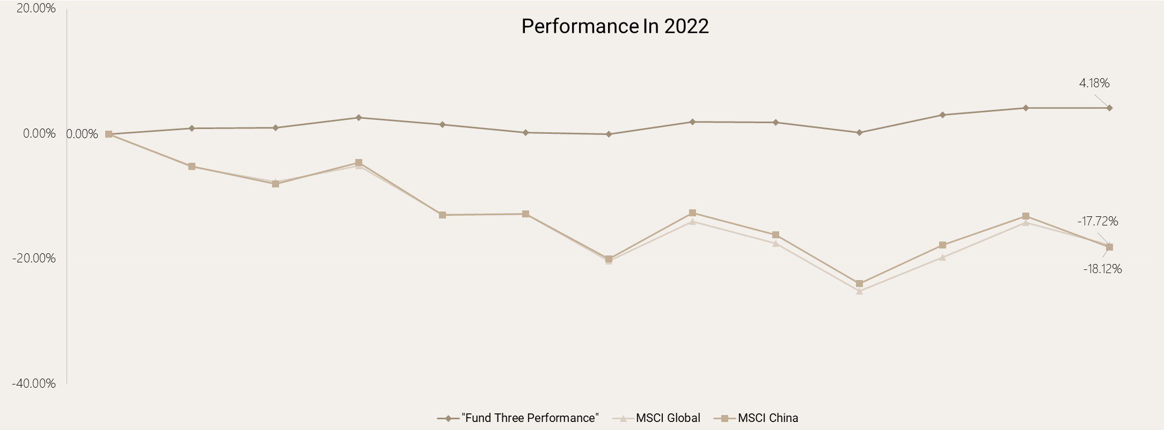
Past performances compared with benchmarks
[INPUT UPDATED LEXINGTON GRAPH]
Fund three
S&P 500
S&P 500
S&P 500

Slide 30
Case four – Japan Activism
This event-driven hedge fund focuses on Japanese corporate events, using activism and shareholder engagement to unlock value. The manager, a descendant of a prominent Japanese political-business family and former leading financial journalist with Wall Street experience, is highly trusted by corporates, making the fund especially effective for activism strategies. It’s a strong Asian diversifier in the portfolio.
Key Metrics
[INPUT UPDATED LIM FACTSHEET FIGURES]
Annualized Return |  | Volatility | Sharpe Ratio | Sortino Ratio | Beta to TOPIX
17.18% |  | 6.96% | 2.47 | 6.01 | 0.23
Historical Performances
[INPUT UPDATED LIM FACTSHEET FIGURES]

Slide 31
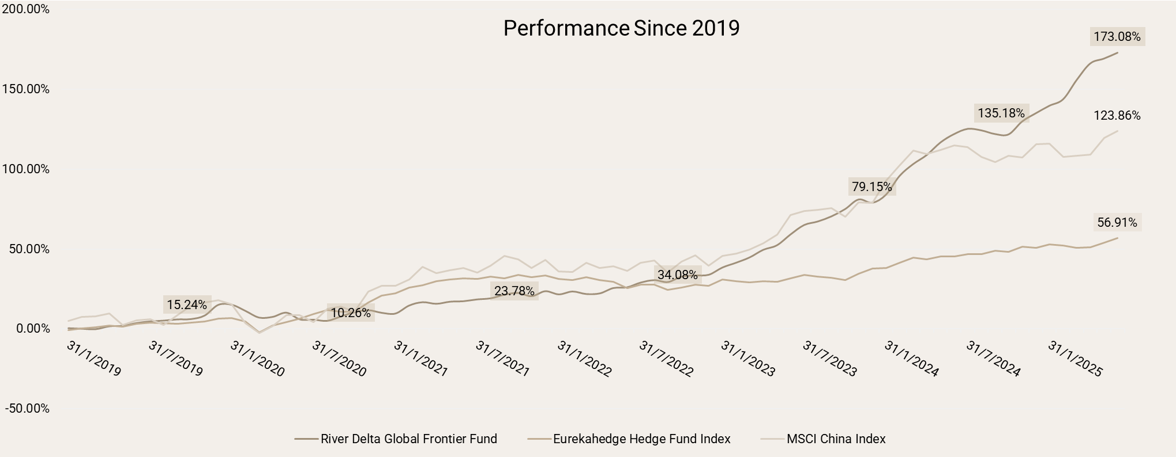
Past performances compared with benchmarks
Inception
[INPUT UPDATED LIM GRAPH]
Fund four
TOPIX

Slide 32
Case five – Global Credit
The Special Situation fixed income fund is a strategy diversifier in our portfolio, leveraging deep expertise across EU, APAC, and US credit markets to capture opportunities from shifting policies and macro trends. Led by a mainland China-born, Harvard math graduate and former D.E. Shaw Credit PM from New York now based in Hong Kong, the fund brings a unique global perspective and exhibits near zero correlation to major markets.
Key Metrics
[INPUT UPDATED FOREST FACTSHEET FIGURES]
Annualized Return |  | Volatility | Sharpe Ratio | Sortino Ratio | Beta to MSCI China
17.66% |  | 8.95% | 1.97 | 3.93 | 0.01
Historical Performances
[INPUT UPDATED FOREST FACTSHEET FIGURES]

Slide 33
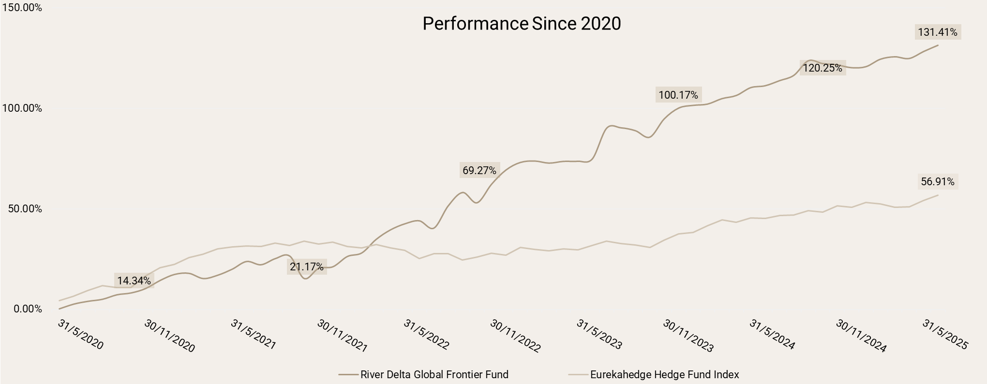
Past performances compared with benchmarks
Inception
[INPUT UPDATED FOREST GRAPH]
Fund five

Slide 34
Appendix River Delta Wealth Management Background

Slide 35





River Delta Wealth Management
The Investment Manager of River Delta Global Frontier Fund
2016
2017
2022
2022-23
2024
Single Family Office
Established in Hong Kong
Incorporation
Founded RDWM
Multi-Family
Expanded to UHNW families
Regulation
SFC Type 4 & 9 licenses
RDGFF Launch
Established as investment manager
Investment Manager Credentials
Regulatory Status: Licensed by Hong Kong SFC with Type 4 (Advising on Securities) and Type 9 (Asset Management) licenses
Investment Infrastructure: Robust investment operations, risk management, compliance frameworks, and reporting systems
Talent Development: Investment team with extensive hedge fund research experience, focused on RDGFF's portfolio
Investment Manager's Role for RDGFF
As Investment Manager, RDWM is responsible for investment decisions, portfolio construction, risk management, and manager selection.
Evolution from family office to licensed asset manager built the institutional foundation for RDGFF's exceptional results.
Manager's Investment Philosophy
RDWM applies investment expertise through a disciplined approach focused on delivering consistent absolute returns across market cycles. The firm's family office heritage brings a principal-oriented mindset to capital preservation while seeking attractive risk-adjusted returns.

Slide 36





River Delta Wealth Management
Our services dedicated to providing the highest level of client satisfaction
Trust Solutions
Professional trust establishment, management, and third-party services
Global Compliance Support
Ensuring adherence to international standards and regulatory requirements
Legal, Tax & Identity Planning
Expert guidance on legal structures, tax optimization, and identity solutions
Migration & Identity Planning
International residence and citizenship solutions for global mobility
Asset Protection & Inheritance
Comprehensive strategies for protecting and transferring wealth across generations
Family Business Consulting
Expert guidance on family business governance and succession planning
Consolidated Reporting
Integrated financial reporting systems for transparency and compliance
Concierge Services
Education, healthcare, real estate, philanthropy, and lifestyle management

Slide 37





River Delta Wealth Management
Investment Solutions
Fixed Income
Disciplined strategies for stable returns across market cycles.
PE / VC
Entrepreneurial capital strategies for growth and long-term value creation.
Experienced Team
Seasoned professionals with 15+ years navigating multiple interest rate and credit cycles
Value-Driven Expertise
Focused on identifying, funding, and scaling businesses to deliver lasting value
Risk-Balanced Approach
Low volatility and minimal leverage strategies focused on capital preservation
Partnership Approach
Active collaboration with founders and teams to drive sustainable growth
Innovative Methods
Blend of traditional economic analysis with advanced quantitative techniques and AI
Growth Builders
Supporting companies through capital, strategy, and networks to accelerate expansion

Slide 38
Appendix Strategic Partnerships

Slide 39



RDGFF Strategic Partnerships
[UNLIKELY BUT VERIFY IF CHANGE]
Background information on RDGFF product support and investment manager relationships
RDGFF Product-Specific Partners
BANKING
LEGAL
AUDIT
ADMIN
DBS Bank
Fund Banking Services
Ogier (Cayman)
Jun He (HK)
Fund Legal Counsel
Apex Fund Services Ltd. Administration
KPMG LLP
Audit Services
Operational Framework
RDGFF Governance: Independent fund oversight, separate from investment manager
RDGFF Product Infrastructure
The RDGFF product is supported by world-class service providers ensuring highest standards of governance, operational excellence, and investor protection.
Regulatory: CIMA compliant; Investment manager regulated by HK SFC (Type 4 & 9)
Clear Separation: Distinct boundaries between RDGFF (product) and RDWM (manager)
Manager Evolution: Single family office to multi-family office since 2016

Slide 40

River Delta Third Party Partners
Comprehensive ecosystem of trusted service providers supporting our clients
Banks and Brokers
Fixed Income Partners
Financial Data Providers
Global banking partners providing custodial services and trade execution
Specialized fixed income trading and research partners
Market data and analytics services for investment research
Premium custodian services
Bond market specialists
Real-time market data
Institutional trading platforms
Credit research expertise
Analytics platforms
Global market access
Structured products access
Research intelligence
Law Firms
Trustees
Compliance
Legal expertise for fund structures, compliance, and transactions
Professional fiduciary and trust management services
Regulatory and compliance advisory services
Ogier (Cayman)
CSC Corporate Trust
Compliance Plus
Jun He (Hong Kong)
Trust administration
SFC Consulting
Fund legal counsel
Fiduciary services
Regulatory expertise

Slide 41



River Delta Third Party Partners
Comprehensive ecosystem of trusted service providers supporting our clients
Banks and Brokers
UBS
Morgan Stanley
Julius Baer
LGT
DBS
HSBC
CITI
Bank of America
BNP Paribas
Nomura
Interactive Brokers
FUTU
HAI Cloud Exchange
Fixed Income Partners
UBS
JP Morgan
Goldman Sachs
Barclays
CLSA
CICC
BOCI
China Citic Bank
Huatai Int’l
China Securities
SPDB Int’l
CNCB Investment
Haitong
Admiralty Harbour
SMBC
MIZUHO
Financial Data Providers
Bloomberg
Refinitiv
FactSet
Morningstar
S&P Capital IQ
Preqin

Slide 42



River Delta Third Party Partners
Comprehensive ecosystem of trusted service providers supporting our clients
Legal
Trustees
Ogier (Cayman)
Jun He (HK)
CSC
TMF Group
King&Wood Mallesons
Hankun
VISTRA
Trident Trust
Zhong Lun Law Firm
Charles RussellSpeechlys
Lion Trust
IQEQ
Withers Khattarwong
Baker McKenzie
Butterfield
Audit
Fund Administration
KPMG LLP
EY
PwC
Apex Fund Services
CITCO
Compliance
CompliancePlus
Compliance Asia (IQEQ)

Slide 43
This document is intended solely for use by the person to whom it is given and may not be reproduced or redistributed. This document is not for distribution to the general public but for intended recipients only and may not be published, circulated, reproduced or distributed in whole or part to any other person without the written consent of River Delta Wealth Management Company Limited (“River Delta”). The entire content of this document, including the logos, texts, graphs, data, and other information (“Document”), belongs solely to the River Delta and is protected by laws reinforcing intellectual property. The disclaimer constitutes an inseparable part of this Document and distribution of this Document without quoting the disclaimer is strictly prohibited. This Document has been prepared for information purposes only without regard to any particular user’s investment objectives or means. This document is not to be construed as a recommendation; or an offer to engagement; or the solicitation of an offer to engagement in any jurisdiction. Information in this document reflect a judgment at the original date of publication by River Delta and are subject to change without notice. River Delta will not be responsible for any loss or damage that could result from interception by third parties of any information contained in this Document, nor will any of the directors, officers or employees, of River Delta, nor any third party will be liable or have any responsibility of any kind for any loss or damage that you incur in the event of any failure or interruption of this Document, or resulting from the act or omission of any other party involved in making this Document or the information or data contained therein available to you, or from any other cause relating to your access to, inability to access, or use of this Document, or reliance upon the information or data contained herein whether or not the circumstances giving rise to such cause may have been within the control of River Delta. In no event will River Delta, directors, officers or employees or any such parties be liable to you for any direct, special, indirect, consequential, incidental damages or any other damages of any kind even if River Delta or any other party have been advised of the possibility thereof. River Delta reserves the right to amend any information of this Document, as well as terms and conditions of the Disclaimer at its sole discretion from time to time without notice.
Disclaimer

